Slide 1
The Minimum Cost-to-Time Ratio Cycle Problem
By: Nick Rogers

Slide 2
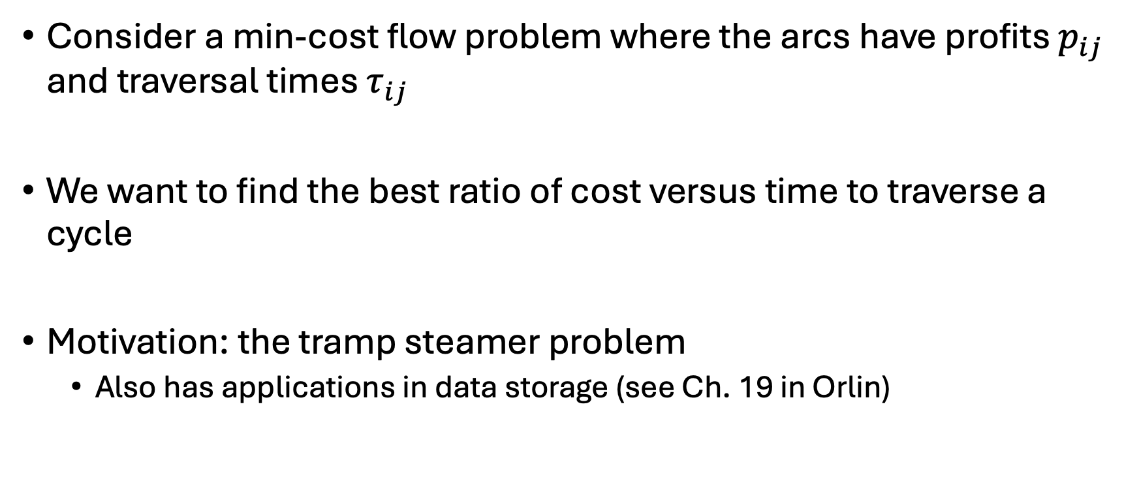
Background
Consider a min-cost flow problem where the arcs have profits $p_{ij}$ and traversal times $τ_{ij}$
We want to find the best ratio of cost versus time to traverse a cycle
Motivation: the tramp steamer problem
Also has applications in data storage (see Ch. 19 in Orlin)

Slide 3
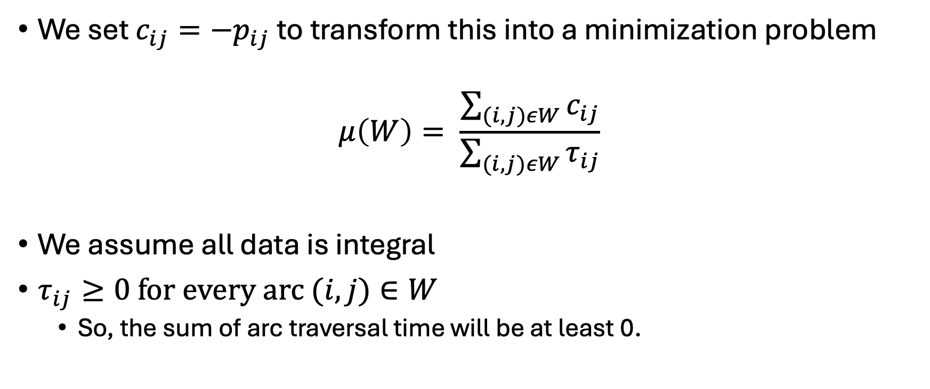
Goal: Find Minimum Cycle
We set $c_{ij}=−p_{ij}$ to transform this into a minimization problem
$$μ\left(W\right)= \frac{\sum_{(i, j)εW}{c_{ij}}}{\sum_{(i, j)εW}{τ_{ij}}}$$
We assume all data is integral
$τ_{ij}≥0 for every arc (i,j)∈W$
So, the sum of arc traversal time will be at least 0.

Slide 4
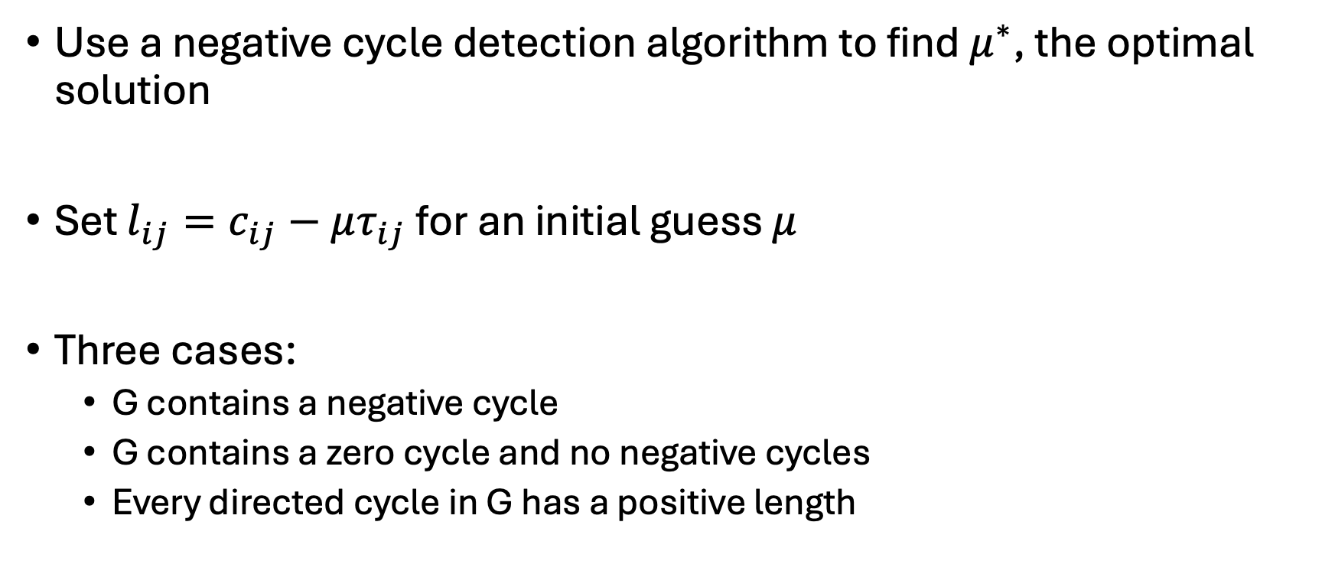

Searching for $μ^{∗}$
Use a negative cycle detection algorithm to find $μ^{∗}$, the optimal solution
Set $l_{ij}=c_{ij}−μτ_{ij}$ for an initial guess $μ$
Three cases:
G contains a negative cycle
G contains a zero cycle and no negative cycles
Every directed cycle in G has a positive length

Slide 5
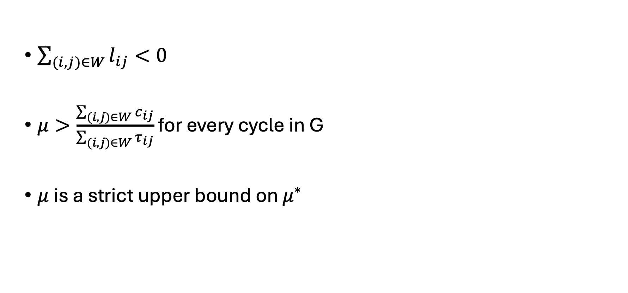
Case 1: G Contains a Negative Cycle
$\sum_{(i,j)∈W}{l_{ij}}<0$
$μ>\frac{\sum_{(i,j)∈W}{c_{ij}}}{\sum_{(i,j)∈W}{τ_{ij}}}$ for every cycle in G
$μ$ is a strict upper bound on $μ^{∗}$

Slide 6
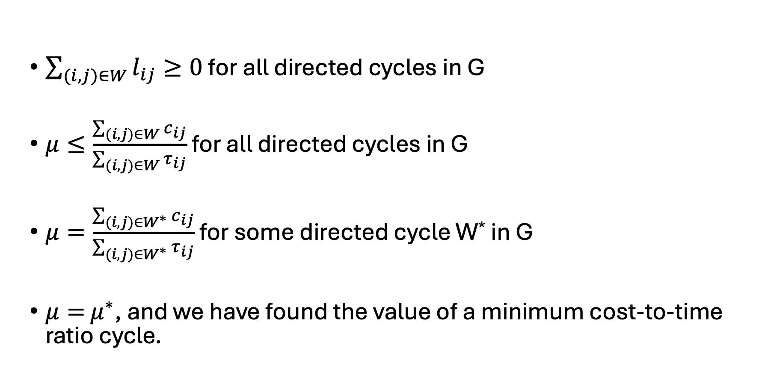
Case 2: G Contains a Zero-Cost Cycle and No Negative Cycles
$\sum_{(i,j)∈W}{l_{ij}}≥0$ for all directed cycles in G
$μ≤\frac{\sum_{(i,j)∈W}{c_{ij}}}{\sum_{(i,j)∈W}{τ_{ij}}}$ for all directed cycles in G
$μ=\frac{\sum_{(i,j)∈W^{∗}}{c_{ij}}}{\sum_{(i,j)∈W^{∗}}{τ_{ij}}}$ for some directed cycle W* in G
$μ=$ $μ^{∗}$, and we have found the value of a minimum cost-to-time ratio cycle.

Slide 7
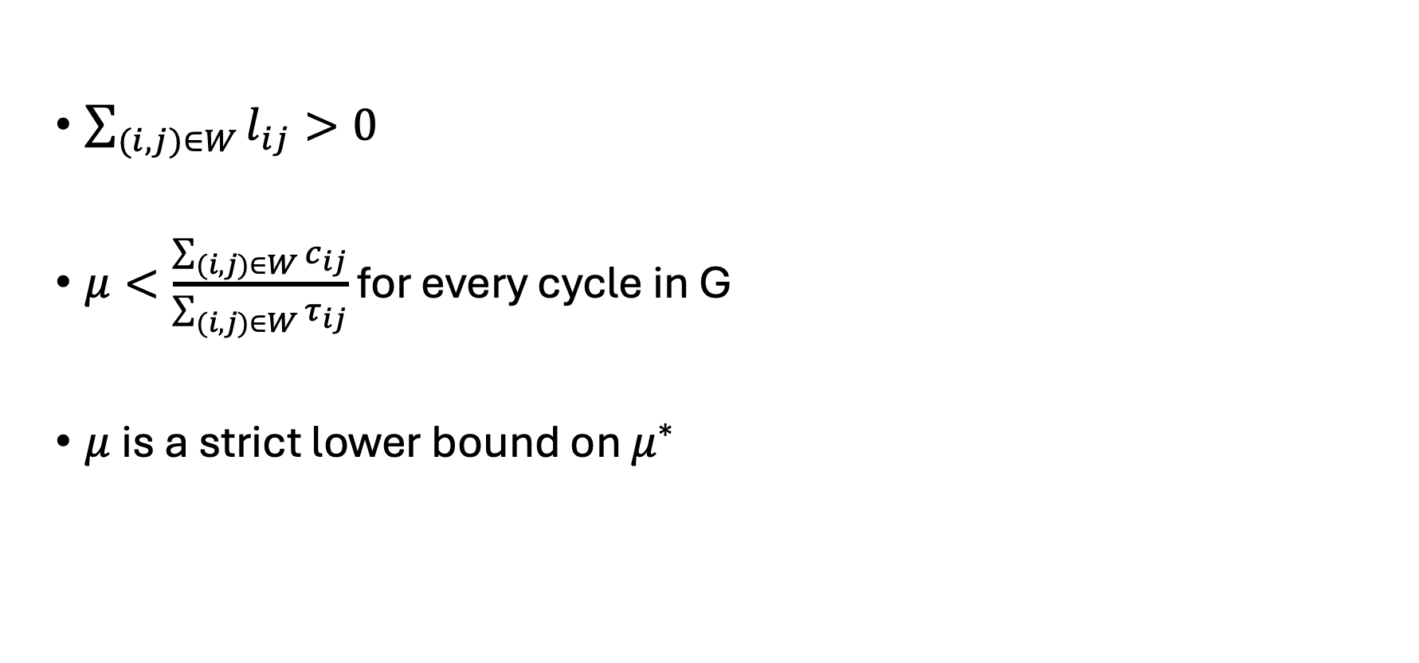
Case 3: G Contains Only Positive Length Cycles
$\sum_{(i,j)∈W}{l_{ij}}>0$
$μ<\frac{\sum_{(i,j)∈W}{c_{ij}}}{\sum_{(i,j)∈W}{τ_{ij}}}$ for every cycle in G
$μ$ is a strict lower bound on $μ^{∗}$

Slide 8
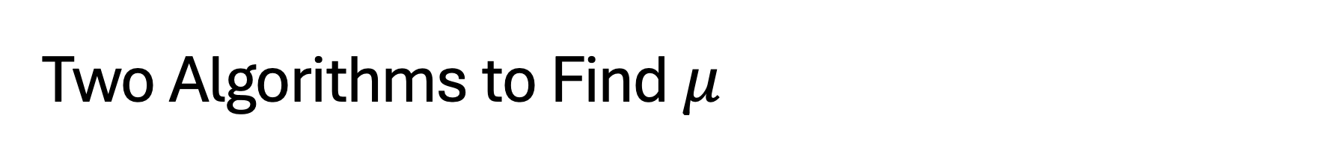
Two Algorithms to Find $μ$
Sequential Search
Binary Search

Slide 9
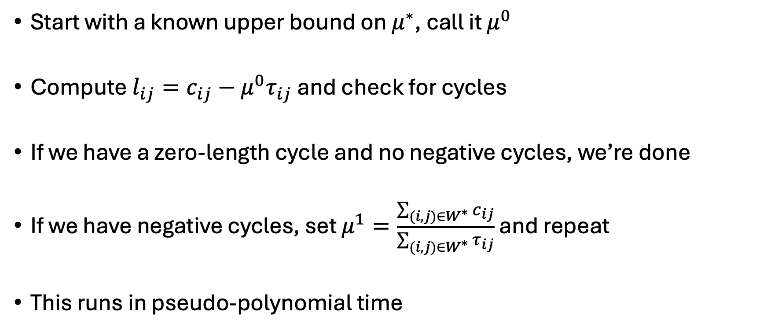
Sequential Search
Start with a known upper bound on $μ^{∗}$, call it $μ^{0}$
Compute $l_{ij}=c_{ij}−{μ^{0}τ}_{ij}$ and check for cycles
If we have a zero-length cycle and no negative cycles, we’re done
If we have negative cycles, set $μ^{1}=\frac{\sum_{(i,j)∈W^{∗}}{c_{ij}}}{\sum_{(i,j)∈W^{∗}}{τ_{ij}}}$ and repeat
This runs in pseudo-polynomial time

Slide 10
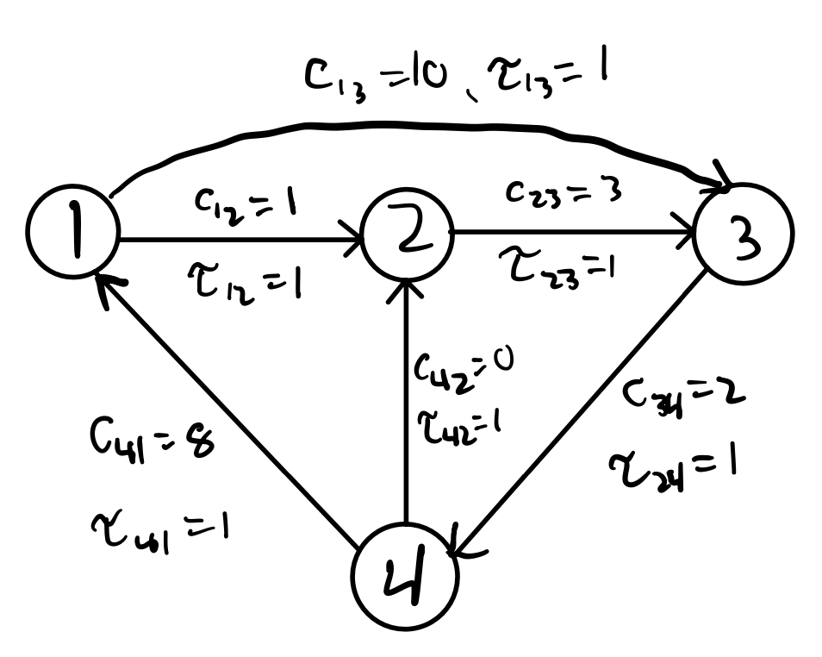
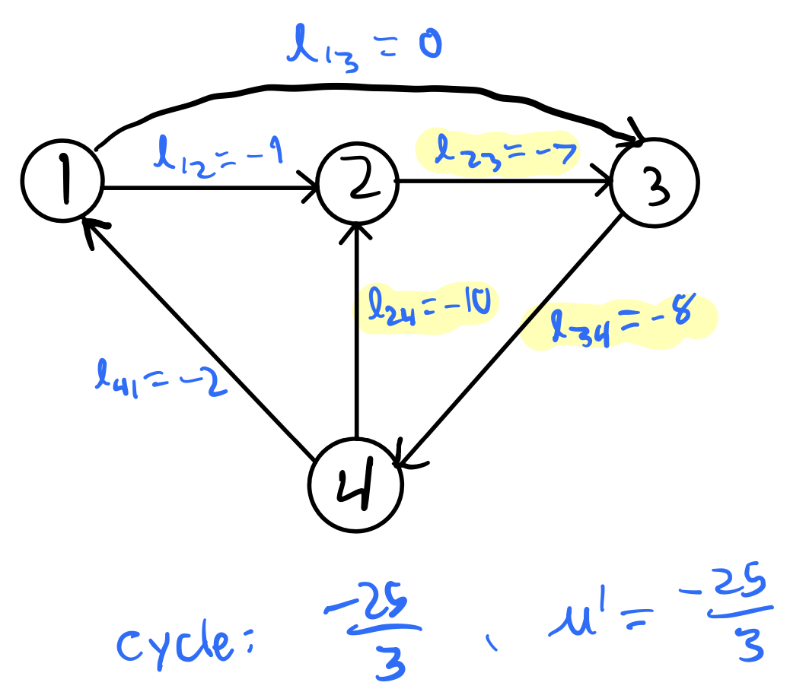

Example: $μ^{0}=10$

Slide 11
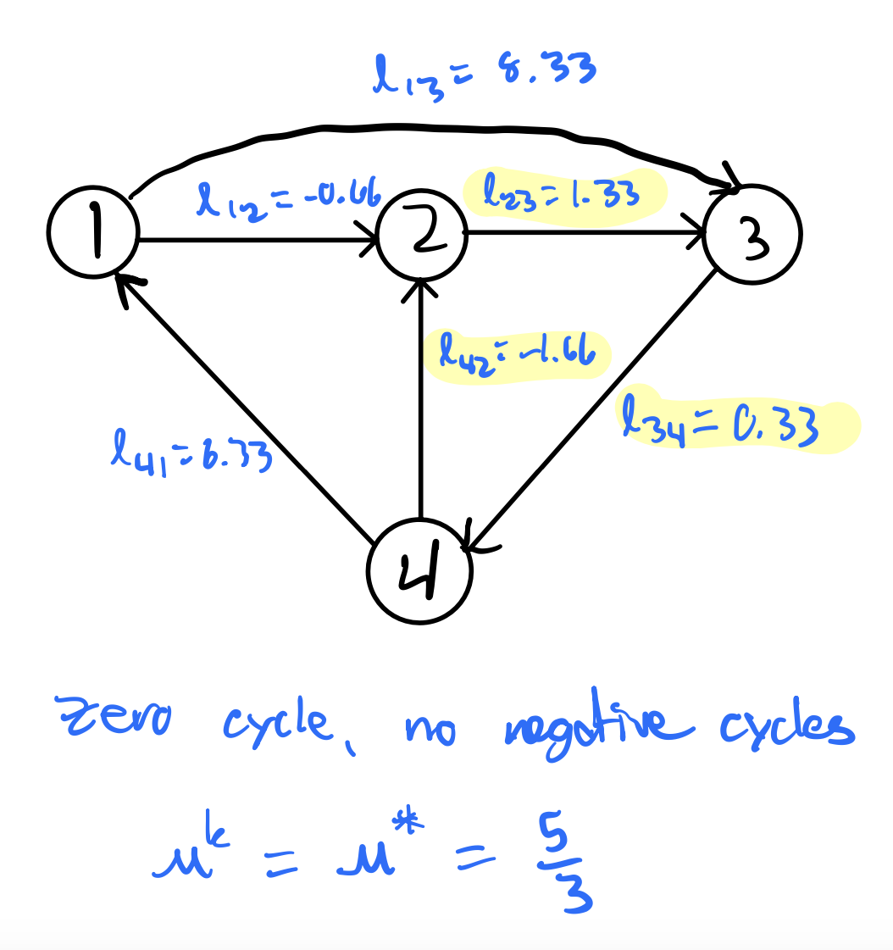

Example: $μ^{k}=\frac{5}{3}$

Slide 12
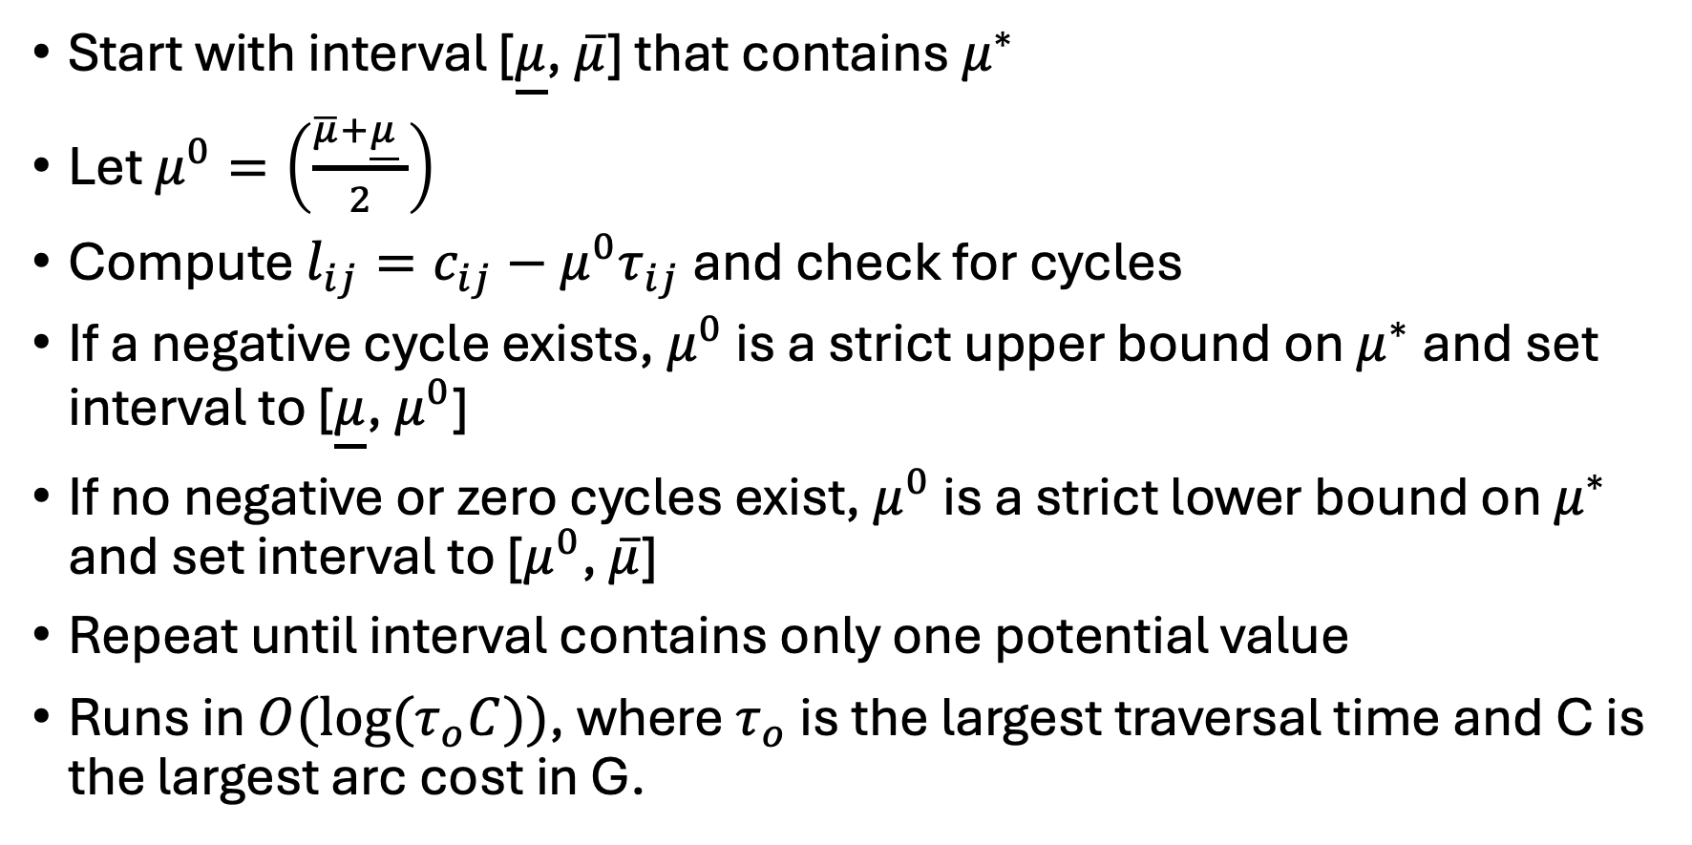
Binary Search
Start with interval [$\underline{μ}$, $\overline{μ}$] that contains $μ^{∗}$
Let $μ^{0}=\left(\frac{\overline{μ}+\underline{μ} }{2}\right)$
Compute $l_{ij}=c_{ij}−{μ^{0}τ}_{ij}$ and check for cycles
If a negative cycle exists, $μ^{0}$ is a strict upper bound on $μ^{∗}$ and set interval to [$\underline{μ}$, $μ^{0}$]
If no negative or zero cycles exist, $μ^{0}$ is a strict lower bound on $μ^{∗}$ and set interval to [$μ^{0}$, $\overline{μ}$]
Repeat until interval contains only one potential value
Runs in ${O(log⁡(τ}_{o}C))$, where $τ_{o}$ is the largest traversal time and C is the largest arc cost in G.

Slide 13
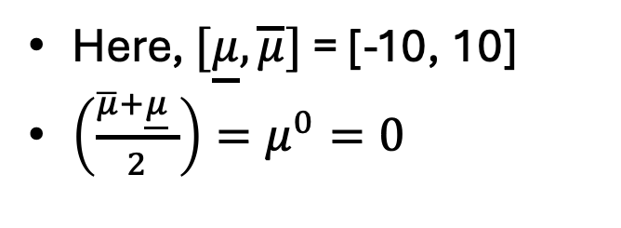
Example
Here, $[\underline{μ}, \overline{μ}]$ = [-10, 10]
$\left(\frac{\overline{μ}+\underline{μ} }{2}\right)=μ^{0}=0$

Slide 14
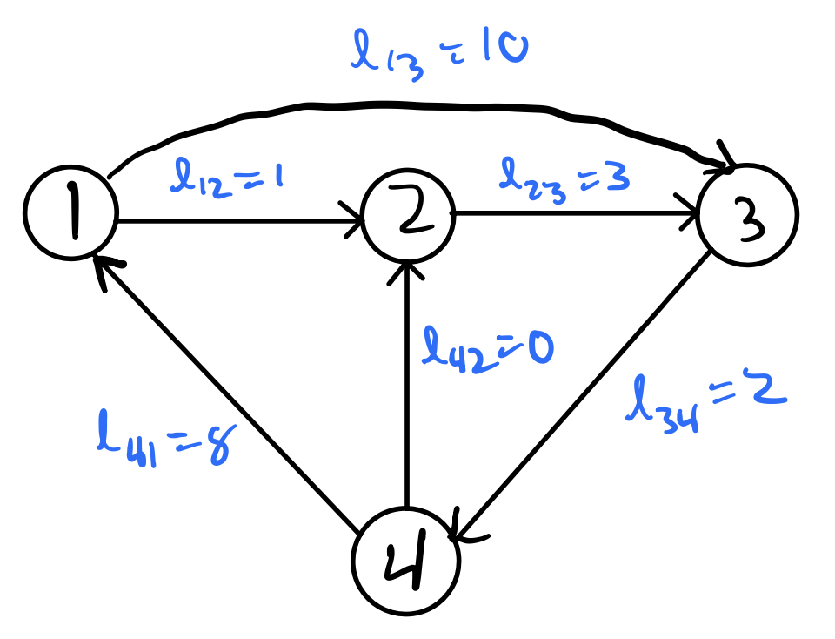
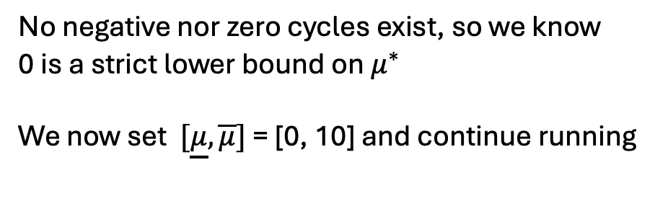
Example
No negative nor zero cycles exist, so we know
0 is a strict lower bound on $μ^{∗}$
We now set $[\underline{μ}, \overline{μ}]$ = [0, 10] and continue running

Slide 15
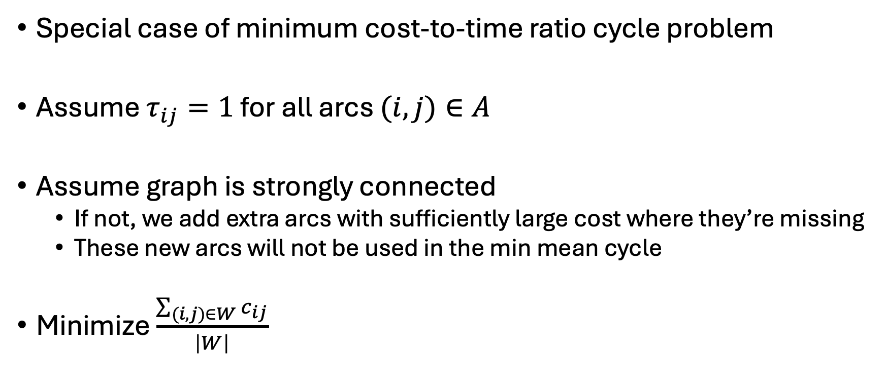
Special Case: Minimum Mean Cycle Problem
Special case of minimum cost-to-time ratio cycle problem
Assume $τ_{ij}=1$ for all arcs $(i,j)∈A$
Assume graph is strongly connected
If not, we add extra arcs with sufficiently large cost where they’re missing
These new arcs will not be used in the min mean cycle
Minimize $\frac{\sum_{(i,j)∈W}{c_{ij}}}{\left|W\right|}$

Slide 16
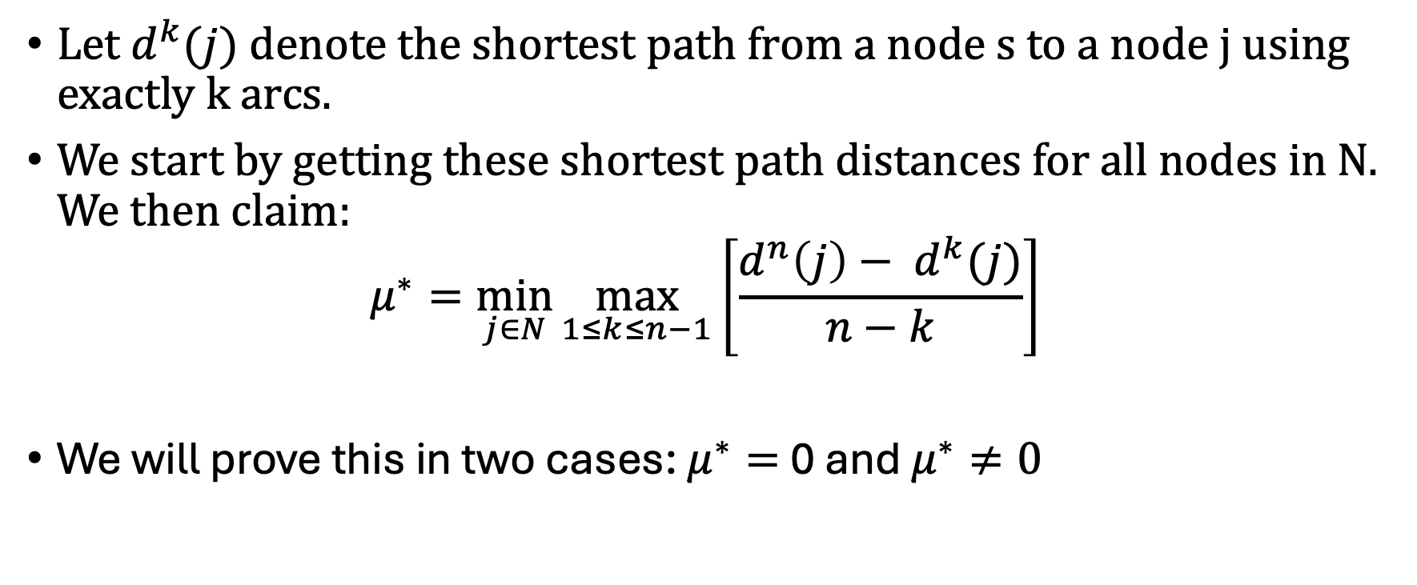
Theorem 5.8
Let $d^{k}(j)$ denote the shortest path from a node s to a node j using exactly k arcs.
We start by getting these shortest path distances for all nodes in N. We then claim:
$$μ^{∗}=\min_{j∈N}{\max_{1≤k≤n−1}\left[\frac{d^{n}\left(j\right)− d^{k}(j)}{n−k}\right]}$$
We will prove this in two cases: $μ^{∗}=$ 0 and $μ^{∗}≠0$

Slide 17
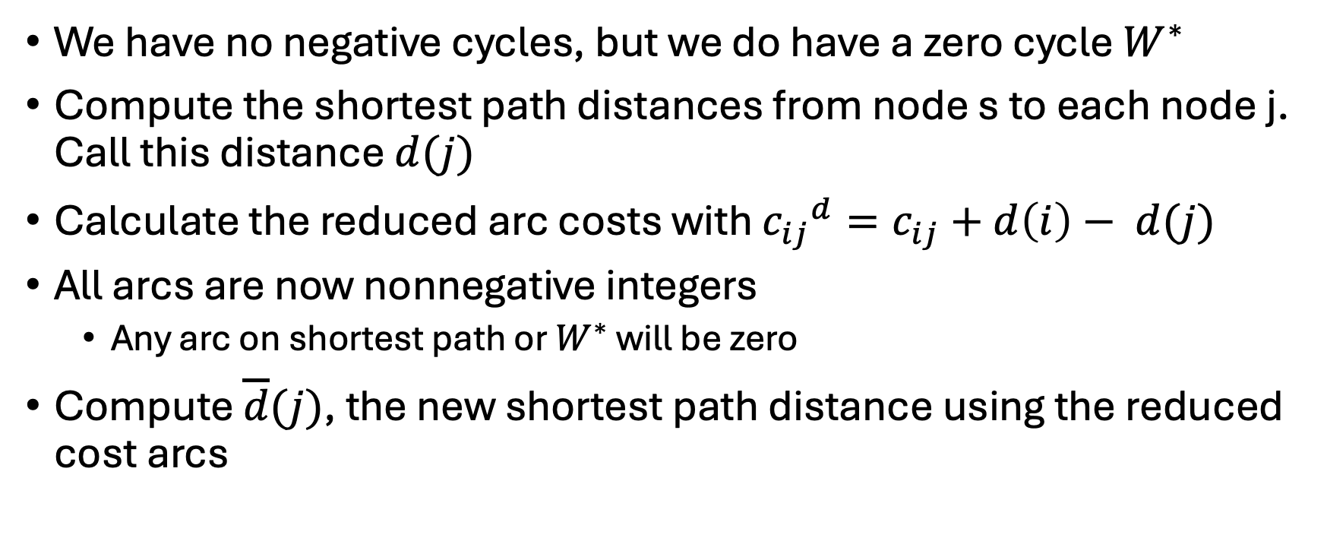
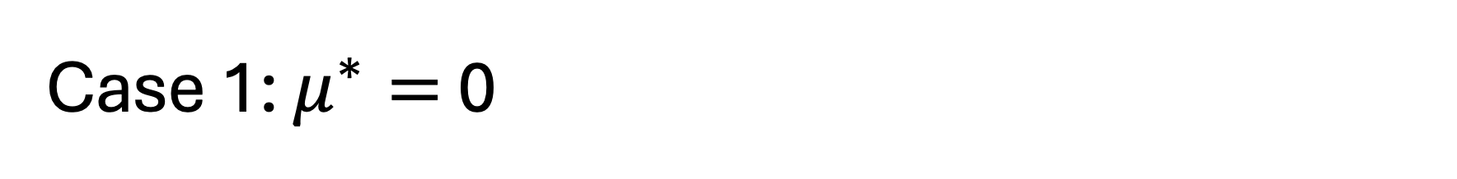
Case 1: $μ^{∗}=$ 0
We have no negative cycles, but we do have a zero cycle $W^{∗}$
Compute the shortest path distances from node s to each node j. Call this distance $d(j)$
Calculate the reduced arc costs with ${c_{ij}}^{d}=c_{ij}+d\left(i\right)− d(j)$
All arcs are now nonnegative integers
Any arc on shortest path or $W^{∗}$ will be zero
Compute $\overline{d}(j)$, the new shortest path distance using the reduced cost arcs

Slide 18
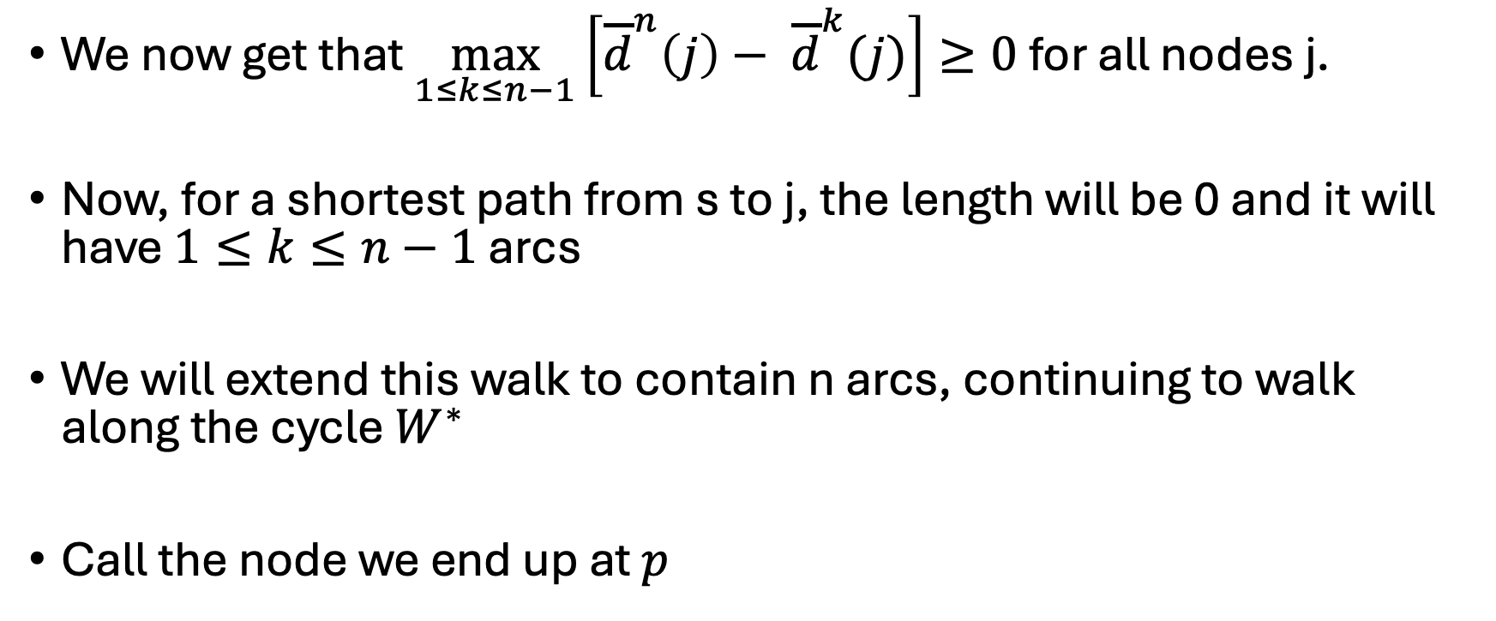
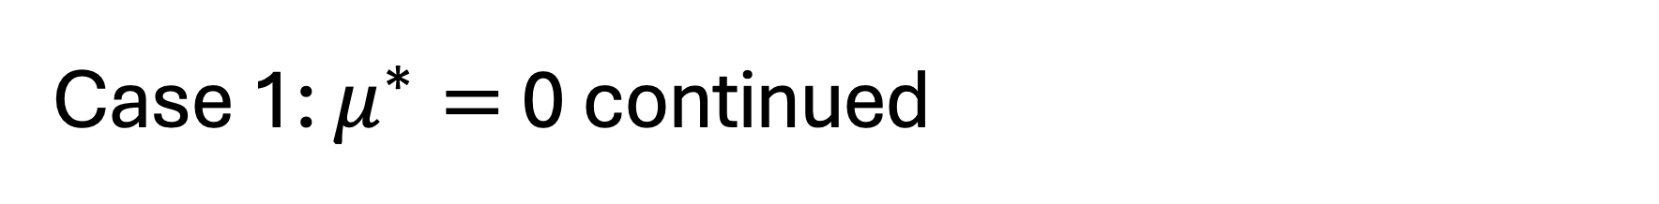
Case 1: $μ^{∗}=$ 0 continued
We now get that $\max_{1≤k≤n−1}\left[{\overline{d}}^{n}\left(j\right)− {\overline{d}}^{k}(j)\right]≥0$ for all nodes j.
Now, for a shortest path from s to j, the length will be 0 and it will have $1≤k≤n−1$ arcs
We will extend this walk to contain n arcs, continuing to walk along the cycle $W^{∗}$
Call the node we end up at $p$

Slide 19
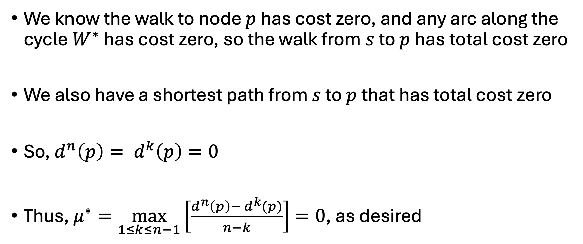
Case 1: $μ^{∗}=$ 0 continued
We know the walk to node $p$ has cost zero, and any arc along the cycle $W^{∗}$ has cost zero, so the walk from $s$ to $p$has total cost zero
We also have a shortest path from $s$ to $p$ that has total cost zero
So, $d^{n}\left(p\right)= d^{k}\left(p\right)=0$
Thus, $μ^{∗}=\max_{1≤k≤n−1}\left[\frac{d^{n}\left(p\right)− d^{k}(p)}{n−k}\right]=0$, as desired

Slide 20
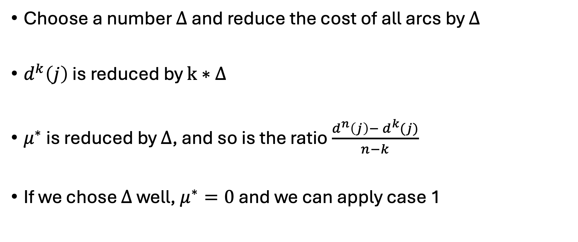
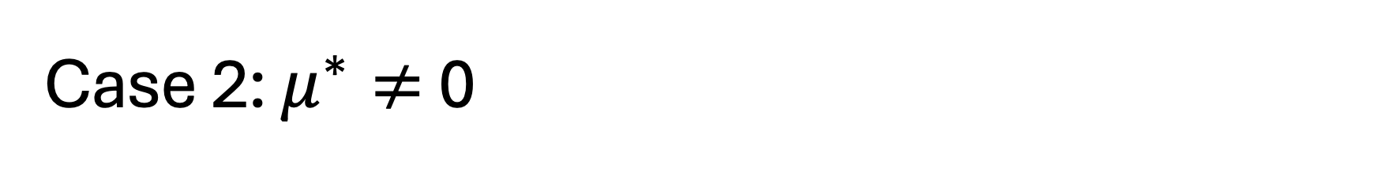
Case 2: $μ^{∗}≠$ 0
Choose a number $∆$ and reduce the cost of all arcs by $∆$
$d^{k}\left(j\right)$ is reduced by $k∗∆$
$μ^{∗}$ is reduced by $∆$, and so is the ratio $\frac{d^{n}\left(j\right)− d^{k}(j)}{n−k}$
If we chose $∆$ well, $μ^{∗}=0$ and we can apply case 1

Slide 21
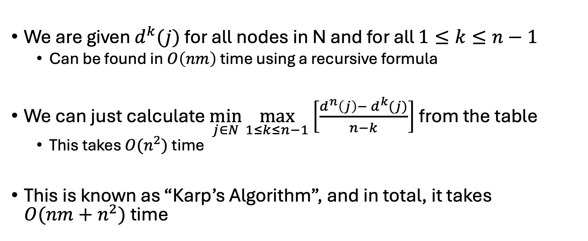
Problem 5.55: prove that the reduced cost shortest path distances can be used to get the min mean cycle
We are given $d^{k}(j)$ for all nodes in N and for all $1≤k≤n−1$
Can be found in $O\left(nm\right)$ time using a recursive formula
We can just calculate $\min_{j∈N}{\max_{1≤k≤n−1}\left[\frac{d^{n}\left(j\right)− d^{k}(j)}{n−k}\right]}$ from the table
This takes $O(n^{2})$ time
This is known as “Karp’s Algorithm”, and in total, it takes $O({nm+n}^{2})$ time

Slide 22
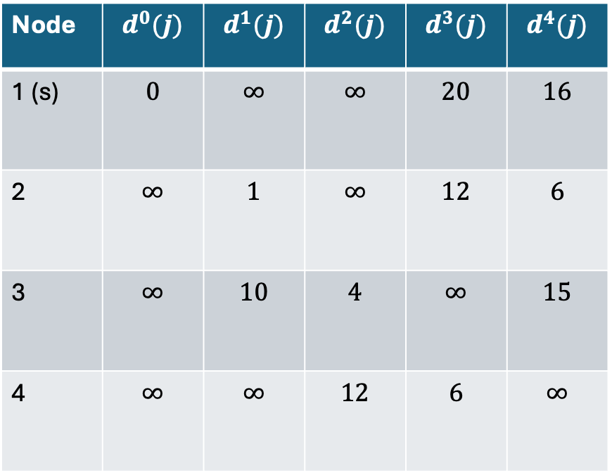
Example (same as before)
Node | $$d^{0}(j)$$ | $$d^{1}(j)$$ | $$d^{2}(j)$$ | $$d^{3}(j)$$ | $$d^{4}(j)$$
1 (s) | $$0$$ | $$∞$$ | $$∞$$ | $$20$$ | $$16$$
2 | $$∞$$ | $$1$$ | $$∞$$ | $$12$$ | $$6$$
3 | $$∞$$ | $$10$$ | $$4$$ | $$∞$$ | $$15$$
4 | $$∞$$ | $$∞$$ | $$12$$ | $$6$$ | $$∞$$

Slide 23
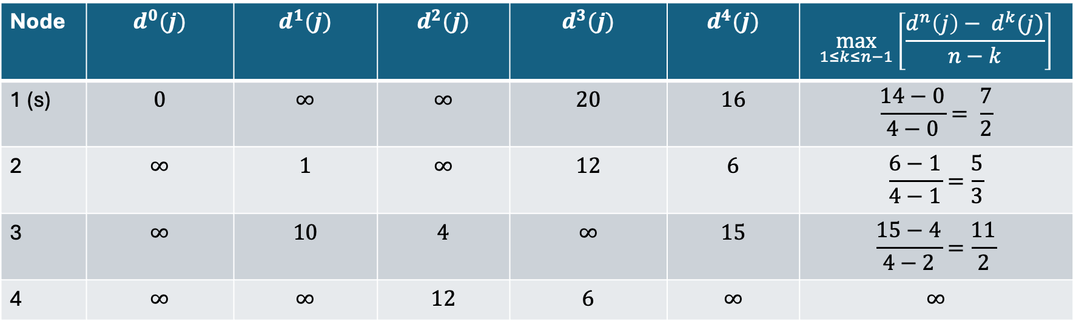

Example (same as before)
We know from before that $μ^{∗}= \frac{5}{3}$
Node | $$d^{0}(j)$$ | $$d^{1}(j)$$ | $$d^{2}(j)$$ | $$d^{3}(j)$$ | $$d^{4}(j)$$ | $$\max_{1≤k≤n−1}\left[\frac{d^{n}\left(j\right)− d^{k}(j)}{n−k}\right]$$
1 (s) | $$0$$ | $$∞$$ | $$∞$$ | $$20$$ | $$16$$ | $$\frac{14−0}{4−0}= \frac{7}{2}$$
2 | $$∞$$ | $$1$$ | $$∞$$ | $$12$$ | $$6$$ | $$\frac{6−1}{4−1}=\frac{5}{3}$$
3 | $$∞$$ | $$10$$ | $$4$$ | $$∞$$ | $$15$$ | $$\frac{15−4}{4−2}=\frac{11}{2}$$
4 | $$∞$$ | $$∞$$ | $$12$$ | $$6$$ | $$∞$$ | $$∞$$

Slide 24
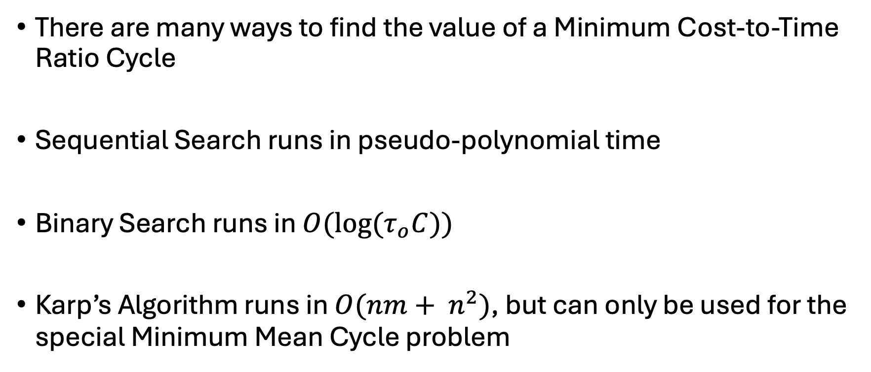
Summary
There are many ways to find the value of a Minimum Cost-to-Time Ratio Cycle
Sequential Search runs in pseudo-polynomial time
Binary Search runs in ${O(log⁡(τ}_{o}C))$
Karp’s Algorithm runs in$O(nm+ n^{2})$, but can only be used for the special Minimum Mean Cycle problem

Slide 25
References
Ravinda K. Ahuja, Thomas L. Magnanti, James B. Orlin. Network Flows. 1993.
Karp, R. M. (1978). A characterization of the minimum cycle mean in a digraph. In Discrete Mathematics (Vol. 23, Issue 3, pp. 309–311). Elsevier BV. https://doi.org/10.1016/0012-365x(78)90011-0

